Slide 1
RTOS-Based Traffic Accident Detection System
CENTRE FOR DEVELOPMENT OF ADVANCED COMPUTING, bANGALORE
GUIDED BY :
Mr. Pavan jadhav
SUBMITTED BY:
Anilesh singh (09)
Tejas chaudhari (29)
VAISHNAVI patil (31)

Slide 2
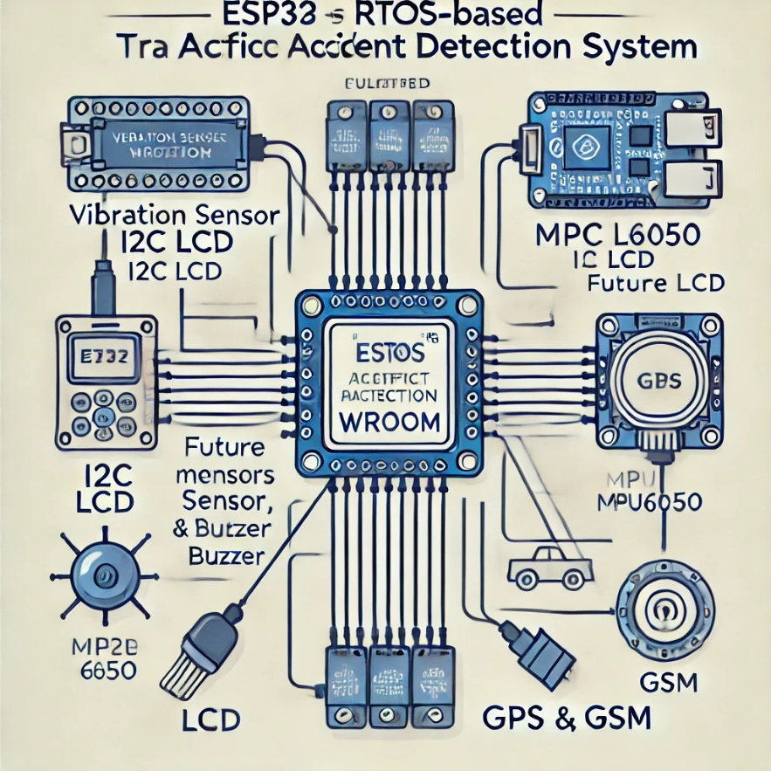
Project Overview
Title: RTOS-Based Traffic Accident Detection System
Objective: The system is designed to detect traffic accidents in real-time using vehicle-mounted sensors. It will send immediate alerts with the accident's severity and location to emergency services.

Slide 3
2. System Design
RTOS Architecture: Describe the planned RTOS (e.g., FreeRTOS) setup, including task scheduling, inter-task communication (queues, semaphores), and how each task will manage specific functions (sensor data reading, accident detection, alerting).
Microcontroller and Sensors:
ESP32 WROOM
MPU6050 (Accelerometer + Gyroscope)
Vibration Sensor
Communication Modules:
NEO-6M GPS Module
GSM 900A
Power Components:
LM2596 DC-DC Buck Converter
Output Devices:
Buzzer Module
LCD/OLED Display
Other Components:
Antennas for GSM and GPS
Battery Backup System

Slide 4
3. Functionality
The RTOS-Based Traffic Accident Detection System efficiently detects vehicle accidents using a vibration sensor and the MPU6050 accelerometer. When a sudden impact is detected, the system evaluates the severity of the collision. The NEO-6M GPS module fetches real-time location coordinates, which are then sent as an alert through the GSM module to pre-defined emergency contacts. The alert message contains GPS coordinates and accident severity data. Additionally, a buzzer is activated to notify nearby authorities about the accident. With RTOS task scheduling, the system ensures seamless handling of tasks like data sensing, location fetching, and communication, enabling faster and more reliable emergency responses.

Slide 5
4. Implementation Process
The development of the RTOS-Based Traffic Accident Detection System was carried out through a structured and sequential approach:
Requirement Analysis: Identified system objectives, selected suitable hardware components such as ESP32 WROOM, MPU6050 sensor, vibration sensor, GPS module, GSM module, and power components to meet the functional requirements.
Hardware Integration: Connected the MPU6050 and vibration sensor to the ESP32 microcontroller to capture impact data. The GPS module was interfaced for location tracking, and the GSM module was configured to send emergency alerts.
RTOS Setup: Deployed FreeRTOS on the ESP32 platform to enable real-time task scheduling. Created tasks for data sensing, severity analysis, location fetching, and message communication.
Algorithm Design: Developed algorithms for accident detection and severity classification. Integrated conditions to analyze impact threshold and trigger alerts based on critical collision levels.
Software Development: Implemented task functions for sensor data acquisition, GPS tracking, and GSM-based alert communication. Developed inter-task synchronization mechanisms to maintain system efficiency.
Testing and Debugging: Verified individual components, tested sensor accuracy, and ensured real-time response under simulated accident conditions. Debugged issues related to task conflicts and communication failures.
Deployment: Conducted final testing in a real-world environment, ensured stable performance, and optimized system efficiency for emergency detection and alert delivery.
.

Slide 6
Algorithm Steps: RTOS-Based Traffic Accident Detection System
Initialize ESP32, sensors (MPU6050, vibration sensor), GPS, GSM, and buzzer.
Configure FreeRTOS tasks for accident detection, location tracking, and alert notification.
Periodically read acceleration and vibration sensor data.
Filter noise and detect sudden changes indicating a possible accident.
Compare sensor values against pre-defined threshold levels.
Fetch real-time location coordinates using the GPS module if the threshold is exceeded.
Format alert message containing accident severity and GPS location.
Send the alert message through the GSM module to emergency contacts.
Activate the buzzer for local notification.
Continuously monitor task execution and synchronization using FreeRTOS.
Handle communication failures and reset tasks if modules become unresponsive

Slide 8
Challenges & Solutions
Accurate Accident Detection:
Challenge: Noise interference from sensors during data collection.
Solution: Implemented filtering algorithms to eliminate false triggers and noise data.
Real-Time Location Accuracy:
Challenge: GPS delays in fetching accurate coordinates.
Solution: Integrated error handling and retries to ensure correct location data capture.
Task Synchronization in RTOS:
Challenge: Conflicts between tasks leading to delays in response time.
Solution: Used semaphores and task prioritization to maintain efficient scheduling.
Communication Failure:
Challenge: Unstable GSM network causing message delivery failures.
Solution: Implemented retry mechanisms for sending alerts and ensured proper signal connection.

Slide 9
8. Future Scope
Cloud Integration: Store accident data on the cloud for analysis and predictive insights.
Vehicle-to-Vehicle Communication (V2V): Enable real-time accident alerts between vehicles for enhanced safety.
AI Accident Detection: Use machine learning to classify accident severity based on sensor data.
Autonomous Vehicle Integration: Enable interaction with autonomous driving systems for better accident management.
Advanced Sensors: Add cameras and LIDAR for improved accident detection and emergency response.
9. Applications
Emergency Response: Automatically alert emergency services with accident location and severity.
Insurance: Assist insurers in verifying accident claims more efficiently.
Smart City: Use data to optimize traffic safety and management.
Public Transport Safety: Ensure the safety of passengers by detecting accidents in real-time.
Fleet Management: Help manage and monitor vehicles, improving safety and reducing risks.

Slide 10
10. Conclusion
The project is progressing well with the breadboard setup complete. Next steps involve integrating additional sensors and refining the RTOS functionality for a more robust system.
The development of the RTOS-Based Traffic Accident Detection System highlights the successful integration of real-time embedded technologies for enhancing road safety. The system effectively detects accidents using advanced sensors and promptly alerts emergency services with accurate GPS information, thereby reducing response time and potentially saving lives.
By leveraging RTOS for efficient multitasking and real-time operations, the solution provides a scalable and adaptable framework for modern automotive applications. This project paves the way for future innovations in smart vehicle safety systems and intelligent transportation networks.

Slide 11
THANK YOU

